Slide 1
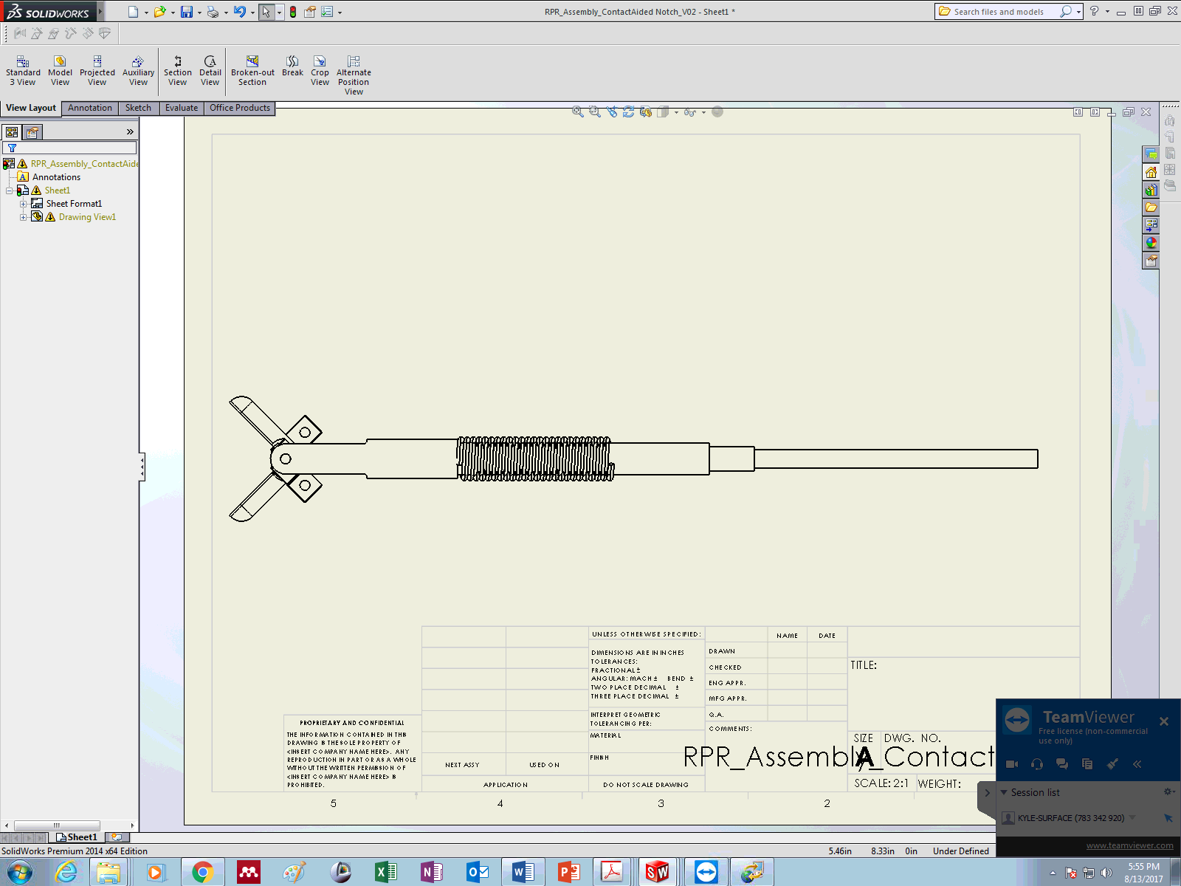
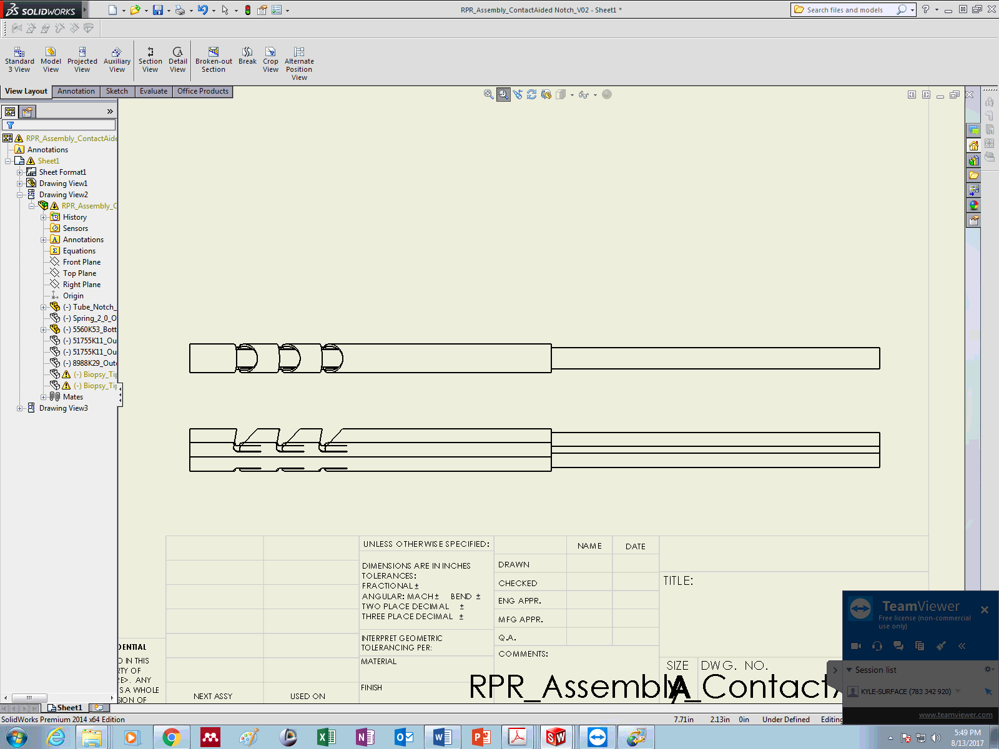
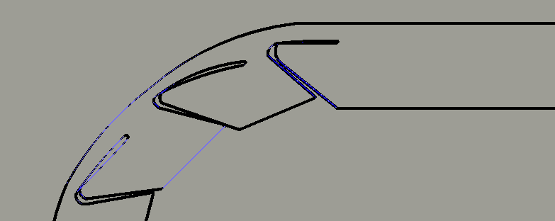



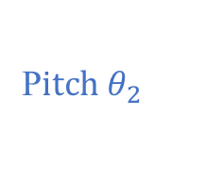

Outer Tube Assembly
Inner Tube Assembly
C_{e}
C₃
(i) Assembled (R-P-R) Wrist
Bearing Tube
Bearing Tube
Roll $θ_{3}$
Roll $θ_{1}$
End-Effector Tendon
Inner Tube Assembly
(ii) Inner Tube (R-P)
C₀ ,C₁
Roll $θ_{1}$
Pitch Actuation Tendon Anchor
Contact-Aided Compliant Joint Segment
C_{2-a}
ooooooo
o
o
C_{2-b}
o
o
(iii) Inner Tube (R-P) Side-View
o
o
o
o
o
o
o
o
oooo
o
o
o
o
o
o
oooo
o
o
o
o
o
o
o
o
o
Roll $θ_{1}$
o
o
o
o
C_{2-c}
o
1 mm
P$itch θ_{2}$

Slide 2
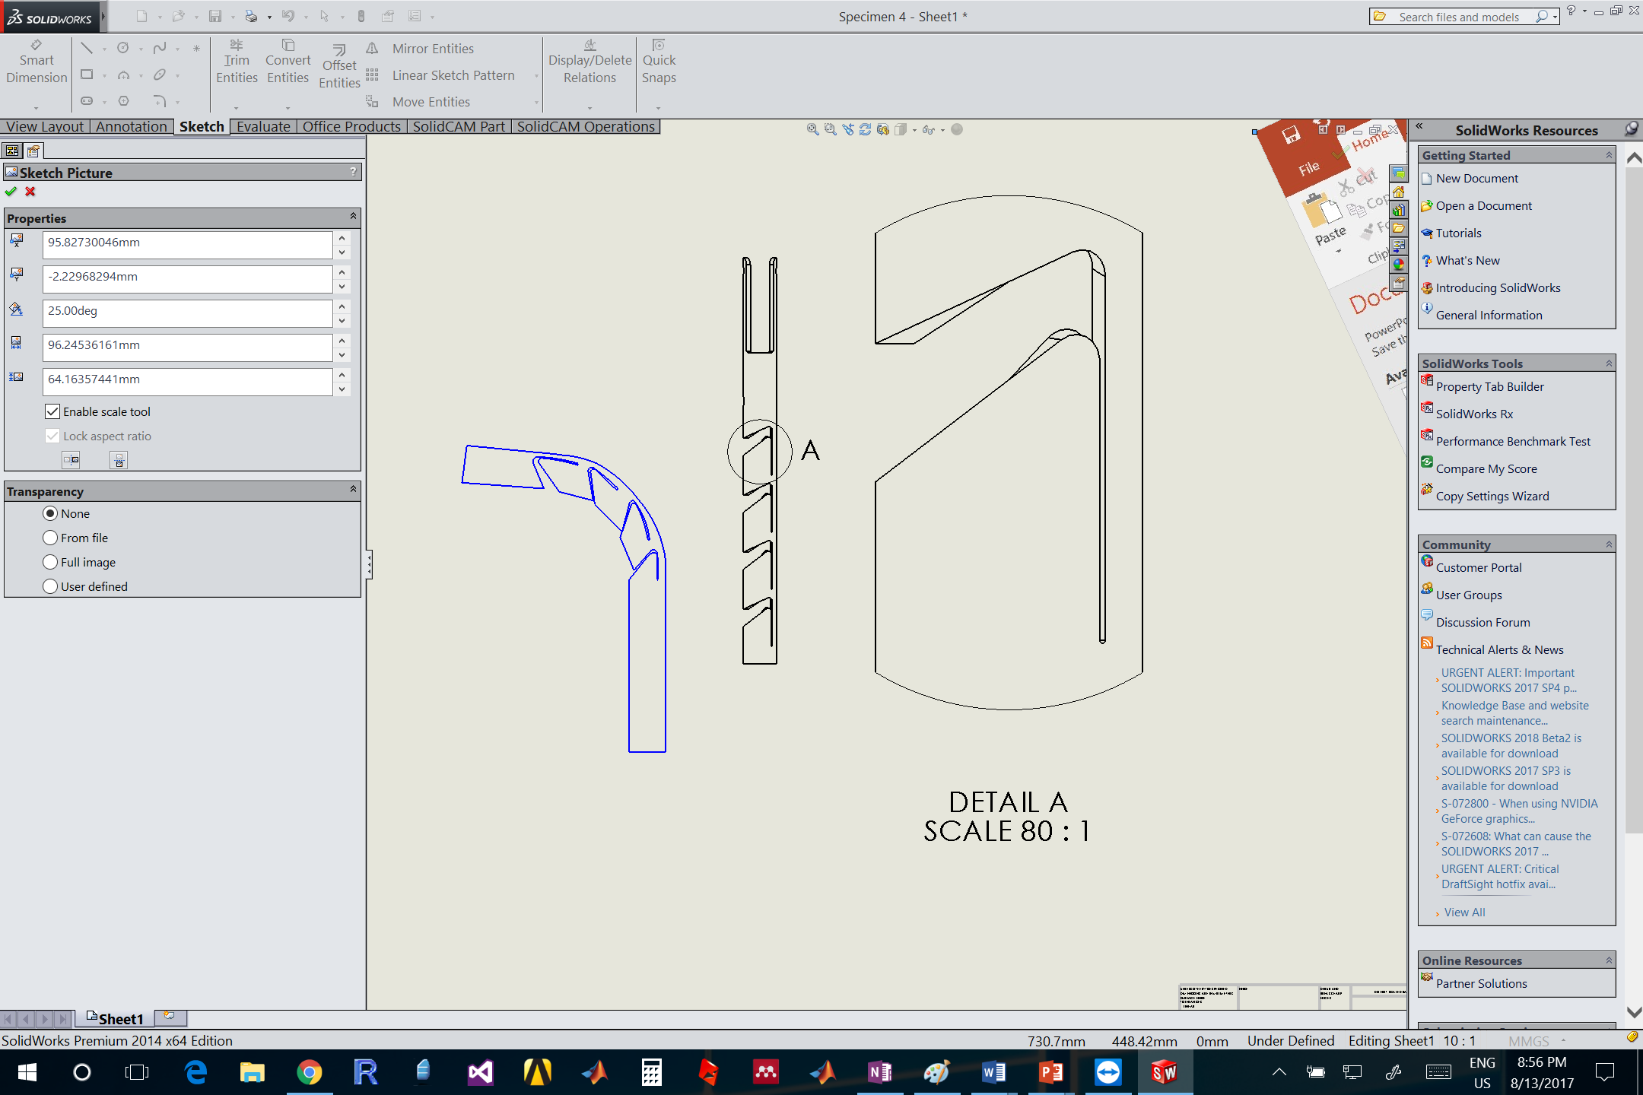






$$γ$$
A
$$S$$
$$R$$
$$φ$$
$$h$$
$$g$$
A - A

Slide 3
